Slide 1
Envision More for Your School Based Practice: Solutions and Inspiration for Key Issues
Perry Flynn, Marie Ireland, Mary Keeney, Marsye Kaplan, Andrea Bertone, Elizabeth Christopher, Jyutika Mehta
Members of the State Education Agencies Communication Disabilities Council (SEACDC)
2019 ASHA Convention

Slide 2
Disclosures
Financial:
Perry Flynn and Marie Ireland are ASHA BOD Members who receive financial support
Some presenters receive financial support to attend the ASHA convention as part of their SEA employment
Nonfinancial:
Presenters have professional affiliations as SEA specialist and SEACDC board member

Slide 3
SEACDC
http://www.seacdc.org/
Consultants working to support speech-language and hearing professionals in schools since ~1939
Members from across the USA
Share information and network to improve services
Collaborate with ASHA to address needs in school settings
Website provides links to regulations and guidance

Slide 4
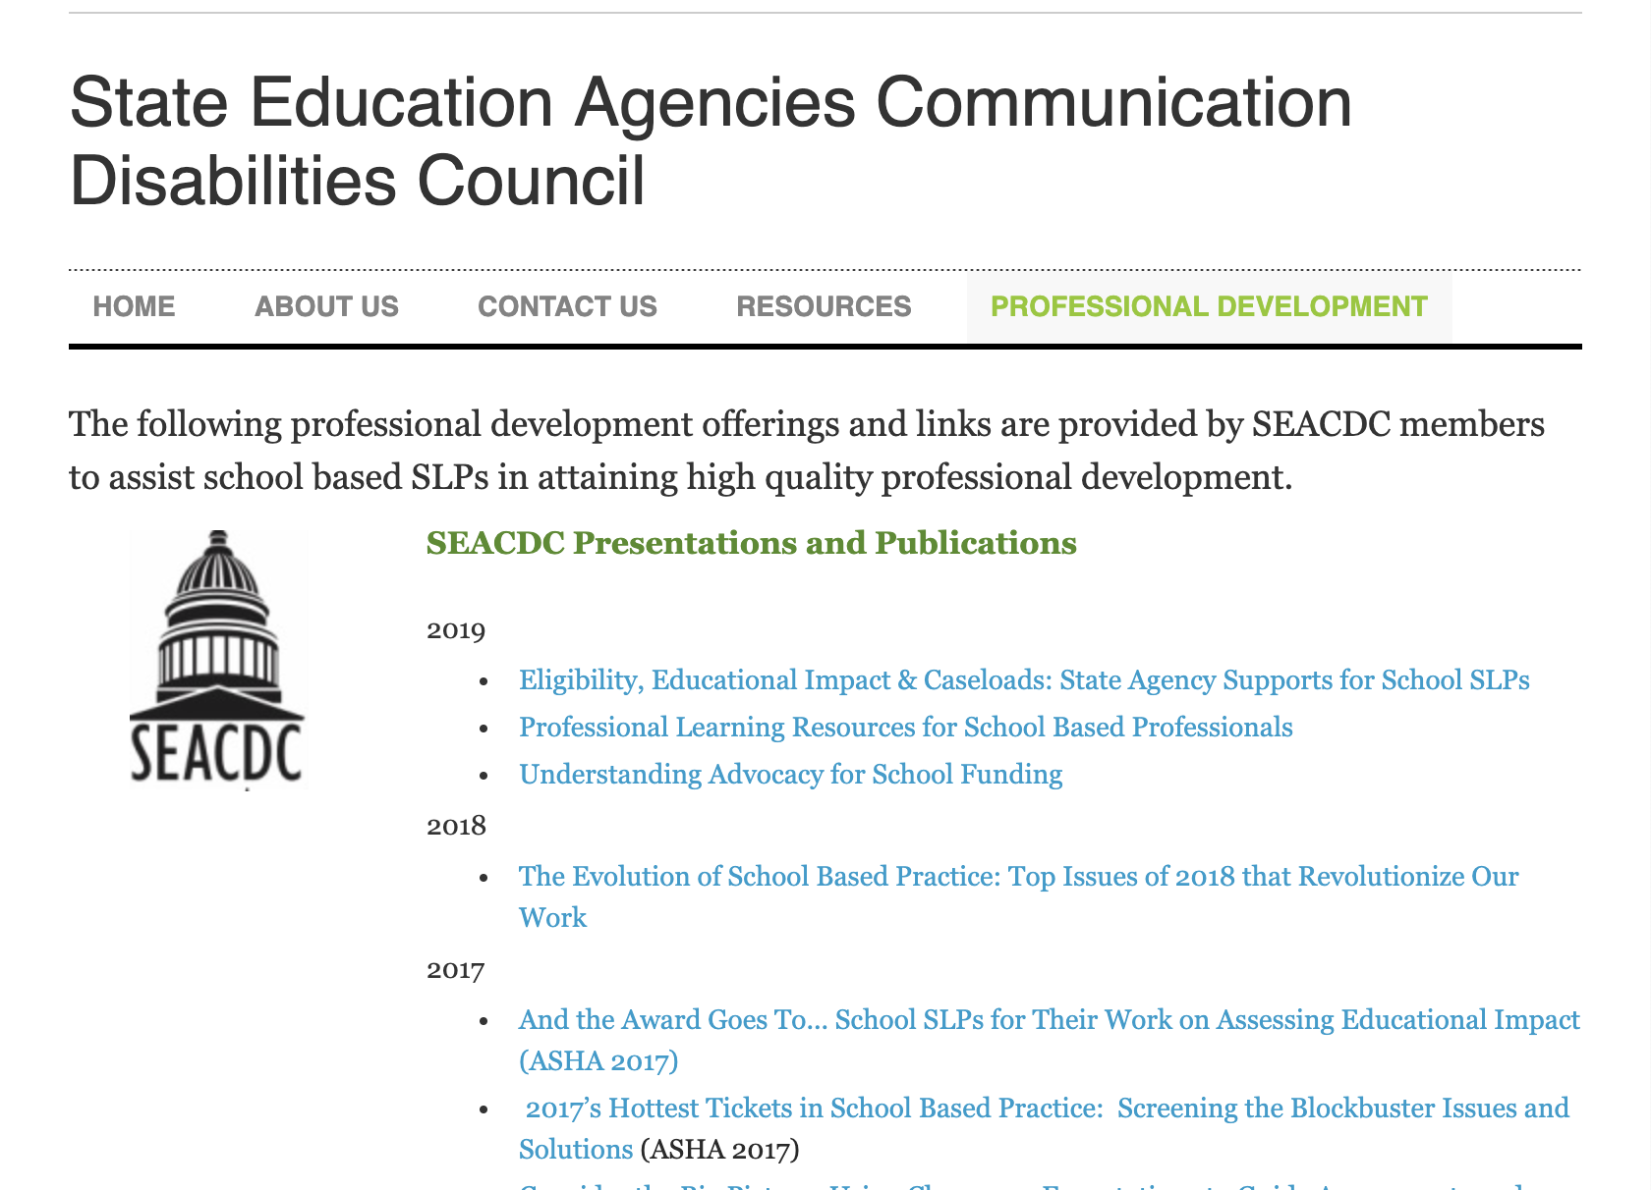
Screen shot

Slide 5
Jurisdiction
Federal and state regulations
Guidance from
Federal
State
Professional Associations (ASHA and others)
Must follow your state’s regulations (e.g., rules, administrative rules, etc.)

Slide 6
Today’s Focus: 5 Key Issues
Comprehensive Evaluation Practices to Address Over-identification
Service Delivery Methods: Incidental Benefit and Data on Least Restrictive Environment
Extenders: Using SLPA, Paraprofessionals, and Others and Practicing at the Top of Your License
General Education: SLPs Role in MTSS, RtI, Pre-Referral Intervention - Approaches, and Solutions from States
A Workload Approach to Caseload Management

Slide 7
Key Issue #1: Comprehensive Evaluation Practices to Address Over-Identification

Slide 8
Regulations
IDEA has specific regulations on evaluation
Tests and other assessment materials be administered in the language that will provide accurate information about what the student knows and can do academically, developmentally and functionally (IDEA, 2004).

Slide 9
Data Based Decision Making
IDEA requires data to document the
Presence of an impairment
Educational impact of the student’s communication impairment
Need for specially designed instruction is required by IDEA.

Slide 10
Federal Accountability Efforts
SPP: State Performance Plan
APR: Annual Performance Report
Indicators: Compliance and Performance Indicators
Part B and Part C
CEIS: Coordinated Early Intervening Services
Voluntary or Mandated
SSIP: State Systemic Improvement Plan
SIMR: State Identified Measurable Result

Slide 11
Evaluation and Eligibility for Speech-Language Services in Schools
Reviews variations in terminology, federal and state regulations, and state, local, and professional guidance for cultural differences, dialect and the impact of poverty
Examines evaluation requirements and examples of differing state requirements and evidence-based recommendations
(Ireland & Conrad, 2016)

Slide 12
Talking EBP
Free Newsletter
2x per year
Need to Know
Test Your Knowledge
Practically Speaking
Working with Data
More to Explore

Slide 13
Research on Evaluation and Bias
Eligibility Criteria for Language Impairment: Is the Low End of Normal Always Appropriate? (Spaulding, T., Plante, E., Farinella, K., 2006)
Factors Influencing the Selection of Standardized Tests for the Diagnosis of Specific Language Impairment (Betz et. al, 2013)

Slide 14
“Perhaps the most discouraging finding of this study was the lack of correlation between frequency of test use and test accuracy…assuming the ideal goal for diagnosis is 100% correct classification of children, accuracy levels should correlate with frequency of test use.” Betz, Eickhoff, & Sullivan, 2013

Slide 15
Cultural and Linguistic Differences and Research on Poverty
A Decade of Disproportionality: A State-Level Analysis of African American Students Enrolled in the Primary Disability Category of Speech or Language Impairment (Robinson & Norton, 2019)

Slide 16
CLD and Poverty Research
Understanding English Language Variation in U.S. Schools (Multicultural Education Series) (Charity & Mallinson, 2011)
The Assessment of Culturally and Linguistically Diverse Populations: a fifty year dilemma: What progress has been made, what issues remain? (Ortiz)

Slide 17
Updates from Speech Sound Disorders Research
Children's Consonant Acquisition in 27 Languages: A Cross-Linguistic Review(McLeod & Crowe, 2018)
Informed SLP: “That one time a journal article on speech sounds broke the SLP internet” (review and blog post)

Slide 18
Research on Language
Establishing Language Benchmarks for Children With Typically Developing Language and Children With Language Impairment (Schmitt et.al., 2017)
Language Sampling Considerations for AAE Speakers: A Patterns- and Systems-Based Approach(Johnson & Koonce, 2018)

Slide 19
More Research on Language
Moving Beyond Mean Length of Utterance: Analyzing Language Samples to Identify Intervention Targets (Pavelko, & Bambinelli, 2018)
Using Language Sample Analysis to Assess Pragmatic Skills in School-Age Children and Adolescents (Timler 2018)
Includes diagnostic criteria for social pragmatic communication disorder
Strategies for language sample collection and analysis

Slide 20
Medical vs. Educational Models
Discuss differing requirements
Educational impact and need for specially designed instruction should be considered in school settings
Guidance available from a few states
Notes:
When a medical dx is presented, groups should address the difference between educational identification under IDEA and medical diagnosis and review the criteria for the specific disability category mandated by the Virginia special education regulations.

Slide 21
Professional Development Resources from States
Videos, Articles, tools, and more!
CO
NC
VA
OHIO
FL
Leadersproject.org

Slide 22
Issue #2 Service Delivery Methods: Incidental Benefit and Data on Least Restrictive Environment

Slide 23
Least Restrictive Environment (LRE)
“To the maximum extent appropriate, children with disabilities, are educated with children who are nondisabled.”
IDEA

Slide 24
Understanding LRE
“Removal from the regular educational environment occurs only if the nature or severity of the disability is such that education in regular classes with the use of supplementary aids and services cannot be achieved satisfactorily.” (IDEA)

Slide 25
Historical Perspective
Services provided in a separate room—away from the general education classroom—have long been the traditional location for speech-language service delivery (ASHA, 2018).
No single model is appropriate for all students, it is imperative to consider a range of service delivery models, as well as the advantages and limitations of each (Nippold, 2012).

Slide 26
Federal Data Collection
40th Report to Congress (Fall 2016 data) reports the percentage of time students with SLI as a primary disability spend in general education
13% of students spend less than 80% of the day in general education
87% of students spend more than 80% of the day in general education

Slide 27
Service Delivery Data
ASHA Schools Survey Trend Report
Majority of SLPs spend 18-20 hours a week doing pull-out services
Shifts in Education
Common Core State Standards, educational policies, ASHA guidelines have “reinvited SLPs to re-examine service delivery” (Meaux & Norris, 2018)
Notes:
From 2014 to 2018, overall, SLPs spent much of their time each week (18–20 hours) in pullout services to students. Schools Survey Report: SLP Caseload Characteristics Trends 2000–2018
American Speech-Language-Hearing Association. (2018). Schools survey report: Caseload characteristics trends, 2000–2018. Available from www.asha.org

Slide 28
30 min 2x Week for Services
“little evidence that this promotes a student’s ability to acquire or generalize speech or language skills”
Flynn, 2010

Slide 29
Indirect service | Direct service
Activities that support student’s success in the general education curriculum Example- SLP works with teacher to reword lengthy test questions and identify difficult vocabulary to assist student | Services provided while in direct contact with a student Example - SLP works directly with student on language skills

Slide 30
Why Terminology is Important
Direct and indirect services make it easy to document “Informed parental consent”.
Consultation may mean either direct or indirect and creates confusion
Medicaid allows reimbursement for services directly to a student - not “on behalf of a student”.

Slide 31
Flexible Service Delivery
Flexible approaches appear to:
Improve overall student outcomes,
Create a better working environment,
Increase consultative time with teachers and parents, and
Enhance services to students (Cirrin, Schooling et al 2010).
Result in more functional goal setting and treatment (Archibald, 2017)

Slide 32
Service Delivery Models
3:1 - (three weeks a month are direct service, one week a month is indirect service) (Annett, 2010)
Collaborative /co-teaching in the classroom**
Cycles (periods of intensive services followed by periods of indirect service)
Pull-out in a separate room
**Ensures relevance to the curriculum, has implications for least restrictive environment (LRE) and has incidental benefit to other students .

Slide 33
Incidental Benefit
“By working together, an effective SLP-educator collaboration has the potential to support more students more effectively in the classroom (Archibald 2017).”
Services may be provided in a regular class even if one or more nondisabled children benefit from these services (34 CFR §300.208).

Slide 34
National Joint Committee on Types of Services
Each setting offers unique advantages for reaching the individual's specific goals. (ASHA, 2018)
Decisions regarding team composition, types, amounts, and duration of services provided, intervention setting, and service delivery models should be based on the individual's communication needs and preferences.
Notes:
National Joint Committee on Types of Services: Direct and Consultative Services

Slide 35
Resources on Service Delivery
VDOE Inclusive Practices
OMNIE – Flexible service delivery module
3:1 Model used in states including:
AZ
OR
OH
VA
ND
WI
FL

Slide 36
Key Issue #3 Extenders: Using SLP Assistants, Paraprofessionals and Others to Practice at the “Top of the License”

Slide 37
Practice at the “Top of the License”
“Audiologists and SLPs should engage in ONLY those [student]
activities that require their level of expertise and skill”.
ASHA Ad Hoc Committee on Refreshing the Professions

Slide 38
How to Practice at the “Top of the License”
Focus attention on activities that require our skills and knowledge
Some tasks, procedures or activities used to treat students can be performed successfully by individuals other than SLPs, if properly trained, such as:
Assistants
Paraprofessionals
Teachers and Parents

Slide 39
Common Tasks in Schools
Plan and prepare materials for therapy
Call parents to schedule IEP meetings
Assess students
Attend meetings
Copy IEPs and file progress reports
Write IEP goals
Direct service with students
Which tasks require the skills of an SLP to do?
Which tasks may be done by others?

Slide 40
SLP Reflections
Review of common tasks
Determine what is:
Necessary for SLP to do
Able to be reallocated
Able to be discontinued
This supports practice at the “top of the license” and manageable jobs!

Slide 41
Using Extenders
Extenders – parents, teachers, paraprofessionals, personal care assistants and SLP Assistants (e.g., SLPA, SLPP, SLT)
The SLP is responsible for understanding federal, state and local regulations for using support personnel and following ASHA guidelines.
Notes:
Some tasks, procedures, or activities used to treat students with communication and related disorders can be performed successfully by individuals other than SLPs, if the persons conducting the activity are properly trained and supervised.

Slide 42
State Examples for Use of SLP Assistants, Aides or Paraprofessionals
NC, AZ, TX, & FL – SLPA license with regulations
ND – SLPP – best practice guidance
OH & WI – No SLPAs – paraprofessionals
HI - Paraprofessionals placed at different levels based on education
VA – No license but scope of work, training and supervision are regulated
Notes:
https://www.txsha.org/assistants_in_texas

Slide 43
State and National Resources
ASHA State by State Guidance
ASHA Practice Portal: Speech-Language Pathology Assistants
ASHA Assistant Certification begins Fall, 2020
State regulations still MUST be followed
ASHA Medicaid Toolkit
ASHA Medicaid in Schools

Slide 44
Supervision Guidance
ASHA Practice Portal: Clinical Education and Supervision
ASHA’s Verification of Skills Form

Slide 45
Data on SLP Assistant or Aide Use
Table 1: Impact of Assistants or Aides on Workload or Caseload
Impact | Workload | Caseload
Increased | 46% | 27%
Decreased | 30% | 36%
No Impact | 20% | 33%
Don’t Know | 4% | 4%
Source: ASHA Schools Survey: SLP Workforce and Work Conditions Report, 2018

Slide 46
Working with Extenders
With support, extenders can
Provide additional practice
Use consistent prompts
Reinforce new skills
Use evidence based strategies
Collect data
The number one reason SLPs in schools engage in interprofessional practice is to improve student outcomes.

Slide 47
Parents as Extenders
“Teaching parents to teach their children allows intervention to occur in the least restrictive environment, their home.”
JSHD - Broen and Wesman, 1990
Family Guided Routines Based Intervention (Birth -3): Florida State University, 2019

Slide 48
Key Issue #4: General Education: SLPs Role in MTSS, RtI, Pre-Referral Intervention - Approaches, and Solutions from States

Slide 49
Options to Support Students
These supports may be delivered using general education initiatives such as
Multi-tiered systems of support (MTSS)
Response to intervention (RTI)
SLP designed pre-referral intervention approaches

Slide 50
MTSS and RtI
MTSS and RTI are designed to:
Monitor academic achievement of all students
Provide instructional supports
Regularly monitor student performance by a team of professionals (may include an SLP)

Slide 51
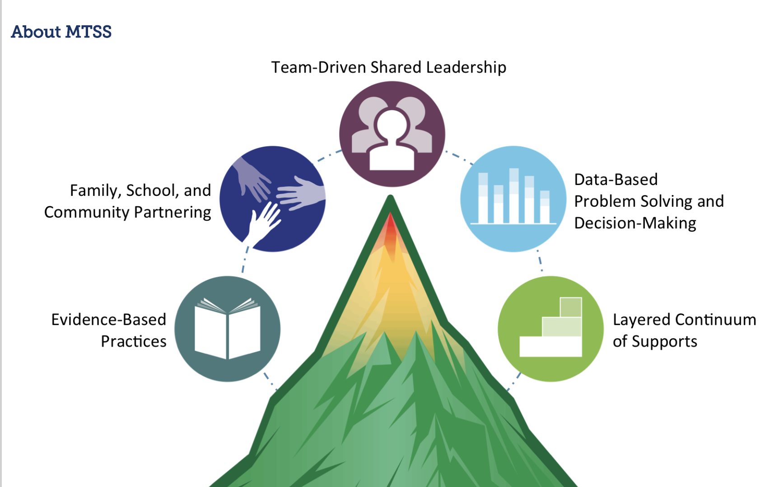
MTSS

Slide 52
RtI
Supports in general education
Provides data for general education team
Data may be shared with eligibility team
A method for determining eligibility
RtI as one or the method for SLD eligibility
NC, VA, WI, ND, OH, FL
FL – Language Impairment eligibility

Slide 53
The SLP’s Role
The SLP’s role in the collection and reporting of student progress within MTSS or RTI systems depends upon SEA and LEA definitions of SLP roles and responsibilities.
If SLPs are funded using IDEA funds may be restricted from working with MTSS or RtI programs

Slide 54
Pre-Referral Intervention
SLP or school specific programs are referred to as pre-referral intervention.
When issues do not impact student learning, pre-referral intervention activities may include
Providing limited practice on speech sounds
Narrative groups to build language skills
Coaching for students with disfluencies

Slide 55
Pre-Referral Intervention
Speech Busters / Sound Breakers / 5 Minute Kids/ Quick Artic
Time limited speech sound programs
Story Champs
Narrative intervention for language
Speech Club
Many states offer these types of pre-referral interventions including:
VA, HI, NC, AZ

Slide 56
No Suspicion of a Disability
In some states, SLPs may provide short term services to students who are not suspected of having a disability but may be at risk or in need of specialized scaffolding to improve communication skills or educational performance.

Slide 57
Issue #5 A Workload Approach to Caseload Management

Slide 58
ASHA 2018 School Survey Report
ASHA supports a workload model in the schools, yet 80% indicate school systems continue to use a caseload approach (ASHA, 2014).
In the ASHA 2016 & 2018 Schools Survey, SLPs identified top issues of
large amount of paperwork
high workload/ caseload size
Notes:
Survey respondents were presented with a list of 17 potential challenges and were asked to select all that applied to them as school-based SLPs. In every type of facility large amount of paperwork ranked as the greatest challenge, followed by high workload/caseload size in second place. The type of facility was related to responses for 12 of the challenges (see Table 2 and Appendix Table C1).

Slide 59
Some States Have
Provided guidance documents or position statements in support of the workload approach (e.g., OH, NC, VA, AZ)
Encouraged workload analysis to improve effectiveness and efficiency and balance workload across the district team (e.g., NC)
Used ASHA’s calculator with all SLPs, OT and PTs (e.g.,Hawaii)
Notes:
HI has distributed asha’s new workload calc to all school based slps, pts and ots and asked for the results turned back in to them……...

Slide 60
What is a Workload Approach?
This approach considers factors including:
Severity of cases (OH)
Transition time and travel
Evaluation of students
Responsibilities in general education / MTSS
Documentation responsibilities
Planning time and time conferring with others
Duty assignments
Staff meeting requirements
Notes:
factors are over and above therapy times

Slide 61
Workload Analysis Reveals
Work habits and patterns
Inconsistencies in decision making
Keeping students who are ready for dismissal
Over identification
Issues with assessment practices
Use of a clinical/medical model
Service delivery issues
Same services for all students
Overuse of pull out services

Slide 62
Workload Challenges & Remedies
SLP was assigned duty 2 days a week | Duty is now covered by a HS student
SLP attending meetings at all 4 buildings | Principals at 3 other buildings agree to keep SLP updated
SLP has extensive transition and travel time | Realign schedule to minimize travel
All students receiving two 20 minute sessions per week. | Changes made via IEP to individualize service delivery and dosage.
Notes:
other ideas-some recommend workload calc 2 x year for all slp staff/re-balance assignments as necessary across district for following year or NOW if needed

Slide 63
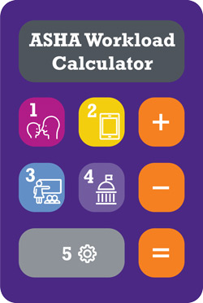
More on Workload
ASHA offers a free workload
calculator
Grassroots efforts to pursue
a workload approach
Understanding Advocacy for School Funding (SEACDC)
Eight guidance videos to support districts’ use of workload & caseload (Ohio)
Notes:
“Implementation of a workload approach is a best practice for school-based hearing and speech-language services, and it ensures compliance with IDEA and other mandates.” p.35
Individuals with Disabilities Education Act (IDEA) Reauthorization
Recommendations of the American Speech-Language-Hearing Association June 2017

Slide 64
Getting Started
Learn about your state and local funding sources
Review workload factors
Check out existing calculators (ASHA, Ohio, etc.)
Build consensus with other SLPs, Admin
Share information about workload with others
Advocate for:
Workload approach at LEA level
Workload approach at SEA level
Funding formula changes

Slide 65
www.seacdc.org

Slide 66
Understanding and Advocating for School Funding
This SEACDC PPT explains funding sources:
General Education
Special Education
Medicaid
Explains accountability programs
Explains advocacy approaches

Slide 67
Questions
Comprehensive Evaluation
Service Delivery Methods
Extenders and Practicing at the Top of Your License
MTSS, RtI, Pre-Referral Intervention
A Workload Approach

Slide 68
Thank you for joining us today!

