Slide 1
Understanding and Advocating for School Funding
Marie C. Ireland, M.Ed., CCC-SLP, BCS-CL
ASHA V.P for SLP Practice

Slide 2
School Funding has Complex and Sometimes Hidden Interactions

Slide 3
School Funding has Complex and Sometimes Hidden Interactions

Slide 4
General Ideas on Funding
General Education
Special Education
Medicaid

Slide 5
General Education

Slide 6
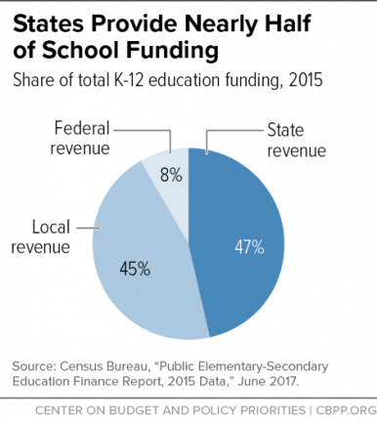
General Education Funds

Slide 7
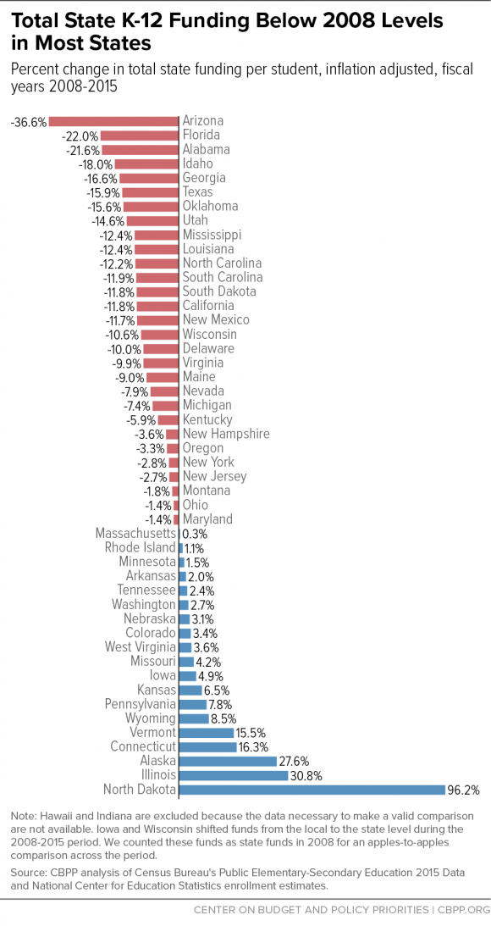
State Funding Comparisons

Slide 8
General Education Funds
Average Daily Membership (ADM) is used for state and local funding
State specific multiplier or adjustment may be used to calculate what each LEA receives
Poverty weighted factor (North Dakota)
Equity funding formula (Ohio)
Composite index (Virginia)
Virginia 15% federal 35% state 50% local | Colorado 10% federal 20% state 70% local

Slide 9
Special Education

Slide 10
Special Education Funding
First, each state is allocated an amount equal to the amount that it received for fiscal year 1999.
Most of the federal funds provided to states must be passed on to LEAs. However, a portion of the funds may be used for state-level activities (e.g., PATTAN, TTAC, etc.)
Current funding is under 17% (federal share)
LEAs make up ~45% of IDEA costs (local share)

Slide 11
Maintenance Of Effort (MOE)
The IDEA also requires each state to maintain:
the level of state financial support for special education and related services from one year to the next.
the LEA’s total expenditures, including State and local contributions, on special education from one year to the next.
This has specific requirements that can create issues for LEAs when enrollment drops or high need students graduate

Slide 12
Funding SLP Positions
Most states award IDEA flow through using a headcount formula for all students with disabilities (e.g., December 1 Child Count)
States cannot change their funding formulas without significant legislative activity
SLP only approach vs entire formula

Slide 13
Medicaid

Slide 14
Medicaid
School-based Medicaid services added in 1988
Legislators amended section 1903(c) of Section 411 of the Medicaid Catastrophic Coverage Act to allow Medicaid reimbursement of health related services to children under IDEA
Medicaid and IDEA combined do not come close to meeting the true cost of services (no double dipping)

Slide 15
Medicaid Misunderstandings
Medicaid in School is cost based reimbursement model - NOT a Fee for Service
Critical features include
State plan
Random moment time study
Administrative claiming
Medicaid reimbursement is provided for LEA expenses not fully funded by IDEA
SLP services do NOT generate “additional” dollars for the LEA

Slide 16
Do SLPs understand the difference between state funding formulas and the concept of a caseload/workload approach? Because the state and local share is so high, how can funding requests be justified?

Slide 17
Other Useful Information

Slide 18
What’s In It For Me?
“When confronted with change, most people tune in to their favorite internal radio station: WIIFM–What’s In It For Me? That’s not to suggest that most people are selfish. It’s simply a fact that personal context is usually the first filter we use to evaluate our environment. It’s especially true when we’re asked to participate in some sort of change.”
https://www.fastcompany.com/3001250/times-change-whats-it-me-question-you-need-answer

Slide 19
Other Drivers that Impact Funding

Slide 20
Federal Accountability Efforts
SPP: State Performance Plan
APR: Annual Performance Report
Indicators: Compliance and Performance Indicators
Part B and Part C
CEIS: Coordinated Early Intervening Services
Voluntary or Mandated
SSIP: State Systemic Improvement Plan
SIMR: State Identified Measurable Result

Slide 21
State Performance Plans/Annual Performance Reports (SPP/APR)
IDEA requires each state to develop a state performance plan/annual performance report (SPP/APR) that evaluates the state’s efforts to implement the requirements of IDEA and describes how the state will improve its implementation.
A state is required to submit a state performance plan (SPP) at least every six years. Each year, states must report against the targets in its SPP in an annual performance report (APR).

Slide 22
Indicators
The SPP/APRs include indicators that measure child and family outcomes and other indicators that measure compliance with the requirements of the IDEA.
20 Part B Indicators (school age)
14 Part C Indicators (pre school age)
Compliance (100% expectation)
Eligibility timelines
LRE placement (where SLP service occurs)
Disproportionate representation
Transition / post school outcomes

Slide 23
CEIS
Set aside can be voluntary or mandated (up to 15%)
CEIS Step by Step Guide
Quick Reference Guide

Slide 24
How informed are school SLPs in your state about things that impact school funding, data collections such as APR, and federal requirements like SSIP and SIMR? Do requests link to SEA and LEA efforts in accountability?

Slide 25
More Factors to Consider

Slide 26
Recruitment and Retention
Caseloads are the most important factor to school SLPs
There is a shortage of SLPs
Vacancies create issues for the LEA:
Compliance with IEPs
Cost of search, interview and onboarding
Staffing rates are higher
Consistency may be impacted

Slide 27
Use State Workforce Data
Data may include
Salary
States recruited from
Years to retirement
Use this data to
Support advocacy efforts
Target recruitment trips
Align LEA practices
Notes:
Examples include
New York
New hampshire
virginia https://www.dhp.virginia.gov/hwdc/docs/ASLP/2202SLP2016.pdf

Slide 29
Workload
Demonstrate Effective and Efficient School Practice

Slide 30
Workload Analysis
Review tasks to determine what is
Necessary for SLP to do
Able to be discontinued
Able to be reallocated
Clerical or paraprofessional
SLPA
Supports “practice at the top of the license”
Makes jobs more manageable

Slide 31
Common Issues to Address
Inconsistencies in evaluation and eligibility decision making
Keeping students who are ready for dismissal
Over identification
Issues with assessment practices
Use of a clinical/medical model
Service delivery issues
Same services for all students
Overuse of pull out services

Slide 32
Regulatory Compliance Reminders
Know the rules and consider the possibilities as they relate to an advocacy request

Slide 33
Compliance with IDEA
IDEA mandates that students must get services as indicated in the IEP
Missed sessions
State testing causing missed sessions
Required make up sessions
Free and Appropriate Public Education (FAPE)
Designed to make progress
Not “de minimus” benefit
Differences between educational and clinical model
Service time
Service location and incidental benefit

Slide 34
Missed Services and State Testing
“...Generally, a special education or related service missed due to participation in required scheduled assessments would not constitute a denial of FAPE and the LEA would not be required to make up the missed service. For a child who is absent from school on testing days due to a parent’s choice, the LEA would not be obligated to make other arrangements to make up the missed services…”
Excerpt from Letter to Kane, April 2018

Slide 35
A Letter about Make Up Services
“ …encourage [schools] to consider the impact of a provider’s absence or a child’s absence on the child’s progress and performance and determine how to ensure the continued provision of FAPE in order for the child to continue to progress and meet the annual goals in his or her IEP. Whether an interruption in services constitutes a denial of FAPE is an individual determination that must be made on a case-by-case basis.”
Excerpt from Letter to Clark

Slide 36
Another Letter on Make Up Services
“…the IEP Team must determine whether the child was denied educational benefit because of the disruption in educational services and whether compensatory education is needed to “make up” for the denial including addressing any skills that may have been lost…”
Excerpt from Letter to Pergament

Slide 37
Make Up Services
State Perspective
Provision of FAPE (Free and appropriate public education)
In accordance with the IEP
Local Perspective
Risk Tolerance of LEA
Banking time in advance

Slide 38
Advocacy in Schools

Slide 39
Advocate Effectively
Learn about your state’s school funding models
Learn about local funding processes
How are Medicaid dollars spent?
What is the financial impact of your request?
WIIFM: How will this change support the LEA?
Efforts in general education or MTSS
Indicator data
Reduce vacancies
What is the true cost of the request?
HR costs
IDEA compliance
Staffing fees

Slide 40
Other Considerations
State Legislation vs. Board of Education
Are there other policy drivers (varies by state)
Agency for Planning and Budget
Agency for Medicaid
Legislative audit and review groups
Other non-profit groups

Slide 41
Advocating for School Funding
Identify the issues and group
Refine your knowledge of
State systems
Local processes
Drivers for change
Select viable targets
Develop your advocacy approach

Slide 42
What information do school SLPs need to advocate for change?

Slide 43
Reference Information and Links
State Reports
List of Part B Indicators
Monitoring indicators and federal requirements
IDEA Data Center Resources
ASHA Medicaid Toolkit “schools”
ASHA Medicaid Toolkit “Medical Necessity”

