Slide 1
The Evolution of School Based Practice: Top Issues of 2018 that Revolutionize Our Work
Perry Flynn, Marie Ireland, Barbara Conrad, Teresa Laney, & Mary Keeney
Members of the State Education Agencies Communication Disabilities Council (SEACDC)
2018 ASHA Convention
Boston, MA

Slide 2
Disclaimer Slide
The presenters have no relevant financial relationship(s) within the products or services described, reviewed, evaluated or compared in this presentation.
The presenters have nonfinancial relationships to disclose as members of the SEACDC. Perry Flynn and Marie Ireland serve on the ASHA BOD.

Slide 3
SEACDC
http://www.seacdc.org/
Consultants working to support speech-language and hearing professionals in schools since ~1939
Members from across the USA
Share information and network to improve services
Collaborate with ASHA to address needs in school settings
Website provides links to regulations and guidance

Slide 4
Today’s Focus: 5 Key Issues
Changes in Federal Legislation and Supreme Court Decisions that Impact School Based Providers
Evidence Based Practices (EBP) and Assessment
Evaluation and Treatment for Students who are English Language Learners
State Issues with SLP Recruitment and Retention in Schools
School Based Funding Models and Understanding What is Required to Adopt a Workload Model.

Slide 5
Key Issue #1: Changes in Federal Legislation and Supreme Court Decisions that Impact School Based Providers

Slide 6
Major Elements of Every Student Succeeds Act (ESSA)
State Academic Standards and Assessments (including the timing and frequency of testing)
Alternate Academic Achievement Standards for Student with the Most Significant Cognitive Disabilities
English Language Proficiency Standards

Slide 7
Major Elements (continued)
Establishment of Long-Term Goals
Annual Measurable Indicators
Annual Meaningful Differentiation
Charter Schools and Public School Choice
Targeted Supports and Improvement

Slide 8
Differences Among States
Your state will have a plan to implement all of these elements.
Visit your state web site or contact your state consultant to learn how each element will be implemented in your state.

Slide 9
New Term for Related Service Personnel
Specialized Instructional Support Personnel (SISP)
This term includes audiologists and speech-language pathologists
ASHA resource: Every Student Succeeds Act Key Issues for ASHA Members
https://www.asha.org/uploadedFiles/Every-Student-Succeeds-Act-Key-Issues.pdf

Slide 10
Comparing §504* and IDEA
Section 504 eligibility
IDEA
A Disability
Negative impact on any major life function (academic achievement or functional performance)
*Of the Rehabilitation Act of 1973
A Disability
Negative impact on academic achievement or functional performance
Need for specially designed instruction

Slide 11
Supreme Court Ruling
Endrew F. v. Douglas County Schools
A student with autism who made minimal or no progress
IEPs must give students with disabilities more than de minimis or minimal educational benefit
IEP teams must consider “What constitutes appropriate progress ?”

Slide 12
Excerpts from the Ruling
“When all is said and done, a student offered an educational program providing “merely more than de minimis” progress from year to year can hardly be said to have been offered an education at all.
For children with disabilities, receiving instruction that aims so low would be tantamount to “sitting idly ... awaiting the time when they were old enough to ‘drop out.’”

Slide 13
Additional Excerpts from the Ruling
“We will not attempt to elaborate on what “appropriate” progress will look like from case to case. It is in the nature of the [special education law] and the standard we adopt to resist such an effort: The adequacy of a given IEP turns on the unique circumstances of the child for whom it was created.”

Slide 14
Practical Implications
Realistic, rigorous but achievable goals that represent legitimate progress should be written in the IEP
The same goals should not appear year after year
Progress should be monitored
If progress is not being made something (pro active) should be done to make progress achievable
Outcomes and progress should be documented and reported

Slide 15
Federal Agency Letters
Letters to explain the position of a federal agency to an individual (Letter to an individual) in response to a specific question
Make up sessions
State testing window
Letters written to a general audience (Dear colleague letter) to address a specific topic
Title II Effective Communication
Establishes philosophy and direction for future

Slide 16
Missed Services and State Testing
“...Generally, a special education or related service missed due to participation in required scheduled assessments would not constitute a denial of FAPE and the LEA would not be required to make up the missed service. For a child who is absent from school on testing days due to a parent’s choice, the LEA would not be obligated to make other arrangements to make up the missed services…”
Excerpt from Letter to Kane, April 2018

Slide 17
A Letter about Make Up Services
“ …encourage [schools] to consider the impact of a provider’s absence or a child’s absence on the child’s progress and performance and determine how to ensure the continued provision of FAPE in order for the child to continue to progress and meet the annual goals in his or her IEP. Whether an interruption in services constitutes a denial of FAPE is an individual determination that must be made on a case-by-case basis.”
Excerpt from Letter to Clark

Slide 18
Another Letter on Make Up Services
“…the IEP Team must determine whether the child was denied educational benefit because of the disruption in educational services and whether compensatory education is needed to “make up” for the denial including addressing any skills that may have been lost…”
Excerpt from Letter to Pergament

Slide 19
Make Up Services
State Perspective
Provision of FAPE (Free and appropriate public education)
In accordance with the IEP
Local Perspective
Risk Tolerance of LEA
Banking time in advance

Slide 20
Issue #2 Evidence Based Practices (EBP) and Assessment
Using “research based interventions to the extent practicable”

Slide 21
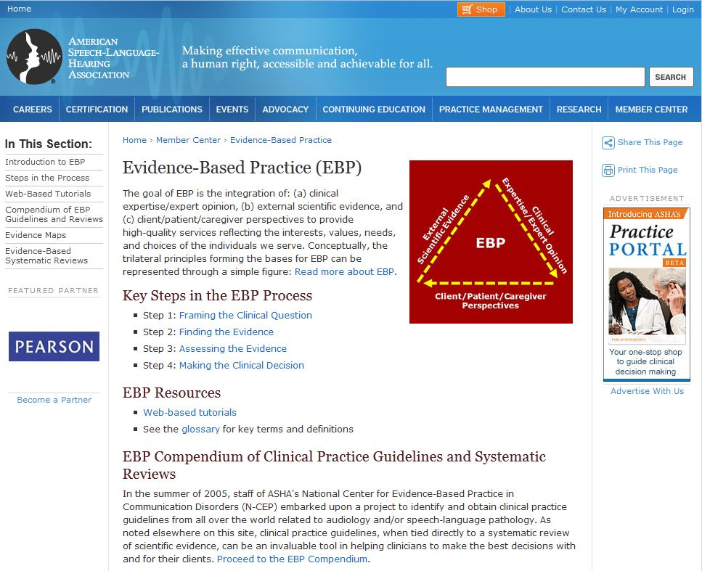

Slide 22
Evidence Based Practices

Slide 23
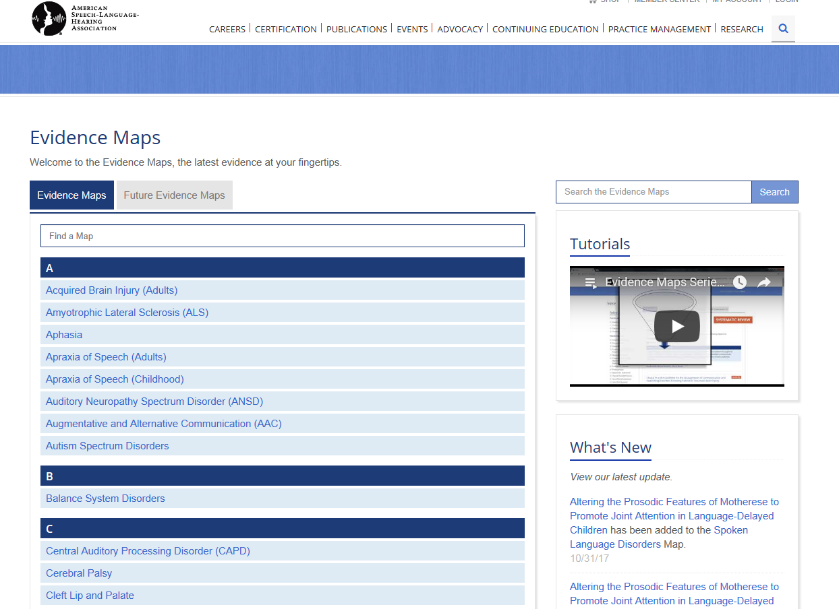

Slide 25
Social Media
Facebook (Informed SLP, SLPs for EBP, etc.)
Twitter (WeSpeechies, Slpeeps
Pinterest (ASHA journals, School Based SLPs, etc.)
What is the authority/evidence?

Slide 26
Review the Evidence
SLPs should consider
Source of the information
Journal
Website
Other publication
Authority
Current or dated

Slide 27
Hexagon Tool for Implementation
Needs of students
Fit
Resource Availability
Evidence
Readiness for Replication
Capacity to Implement
From The Hexagon Tool:Exploring Context

Slide 29
Psychometric Properties of Language Assessments for Children Aged 4–12 Years: A Systematic Review
Fifteen assessments were evaluated.
No assessments presented with evidence of structural validity, internal consistency or error measurement.
Overall, all assessments were identified as having limitations with regards to evidence of psychometric quality.
https://www.frontiersin.org/articles/10.3389/fpsyg.2017.01515/full

Slide 30
Diagnostic Accuracy: Vital Research
Eligibility Criteria for Language Impairment – Is the Low End of Normal Always Appropriate?
Of the 43 tests, acceptable accuracy (80% or better) was reported for only 5.
Spaulding, T. Plante, E. & Farinella, K. (2006) http://lshss.pubs.asha.org/article.aspx?articleid=1762895
Factors Influencing the Selection of Standardized Tests for the Diagnosis of Specific Language Impairment.
The quality of a standardized test, as measured by the test's psychometric properties, does not appear to influence how frequently a test is used.
Betz, S.K., Eickhoff, J.R., & Sullivan, S.F. (2013). http://lshss.pubs.asha.org/article.aspx?articleid=1797328

Slide 31
Comprehensive Assessment Reference Card
Reviews comprehensive assessment process
Reviews data from 18 tests (5 new tests added)
Provides research references

Slide 32
Research Shows Valuable Methods
Language Sample Analysis
Sampling Utterances Grammatical Analysis Revisited (SUGAR)
Narrative Sampling
SLAM Cards
Narrative Protocol for Picture Prompted Stories
Dynamic Assessment
Story Champs
Predictive Early Assessment of Reading and Language (PEARL)
NLM³

Slide 33
Dynamic Assessment Examine Learning Potential and Outcomes
Student Effort
Student Performance

Slide 34
Children's Consonant Acquisition in 27 Languages: A Cross-Linguistic Review
Review of 64 studies of children’s speech sound acquisition
Ages of acquisition may vary from commonly used norms
McLeod, S. & Crowe, K. (2018). Children's Consonant Acquisition in 27 Languages: A Cross-Linguistic Review. Am J Speech Lang Pathol, [Advance online publication], 1-26.

Slide 35
Comprehensive Assessment of Speech Sound Production in Preschool Children
Details on comprehensive speech sound assessment:
standardized single-word testing
additional single-word testing
connected speech sampling
phonological analyses
stimulability testing
may include inconsistency testing
Macrea (2016) http://perspectives.pubs.asha.org/article.aspx?articleid=2529456&resultClick=1

Slide 36
Using Language Sample Analysis to Assess Pragmatic Skills in School-Age Children and Adolescents
Includes diagnostic criteria for social pragmatic communication disorder
Strategies for language sample collection and analysis
Timler, G. R. (2018). Using Language Sample Analysis to Assess Pragmatic Skills in School-Age Children and Adolescents. Perspect ASHA SIGs, 3 (SIG 1), 23–35. doi: 10.1044/persp3.SIG1.23

Slide 37
Talking EBP
Free Newsletter
2x per year
Need to Know
Test Your Knowledge
Practically Speaking
Working with Data
More to Explore

Slide 38
Other Resources to Consider
Characteristics of Auditory Processing Disorders: A Systematic Review (2016) de Wit, E., Visser-Bochane, M. I., Steenbergen, B., van Dijk, P., van der Schans, C. P., & Luinge, M. R. (2016).. J SLHR 59(2), 384-413.
A Psychometric Review of Norm-Referenced Tests Used to Assess Phonological Error Patterns Kirk, C. & Vigeland, L. (2014). LSHSS 45(4), 365-377.
Content Coverage of Single-Word Tests Used to Assess Common Phonological Error Patterns Kirk, C. & Vigeland, L. (2015). LSHSS 46(1), 14-29.
Test Review: PLS-5 LEADERS Project (2013)
Test Review: CELF 5 LEADERS Project (2014)

Slide 39
Resources
www.seacdc.org/resources
http://www.seacdc.org/professional-development.html
https://omnie.ocali.org
www.doe.virginia.gov (Search SLP)
www.leadersproject.org

Slide 40
Key Issue #3 Evaluation and Treatment for Students Who Are Culturally and Linguistically Diverse

Slide 41
National Statistics
According to the National Center for Education Statistics (2011), in 2009 the number of children ages 5–17 who spoke a language other than English in the home was 11.2 million students or 21 percent of the school-age population.
O’Hara, N., Munk, T. E., Reedy, K., and D’Agord, C. (2016, May). Equity, Inclusion, and Opportunity: Addressing Success Gaps White Paper (Version 3.0). IDEA Data Center. Rockville, MD: Westat.

Slide 42
Appropriate Evaluations
To ensure that students are appropriately evaluated, the IDEA specifies that assessments and other evaluation materials must be selected and administered so as not to be discriminatory on a racial or cultural basis
Assessments must be administered in the student's native language or other mode of communication and in the form most likely to yield accurate information on what the student knows and can do, unless it is clearly not feasible to do so (34 CFR §300.304(c)(1))

Slide 43
IDEA Requirements
Districts must consider the English language proficiency of EL students in determining the appropriate assessments and other evaluation materials to be used.
School districts must not identify or determine that EL students are students with disabilities primarily because of their limited English language proficiency. EL must not be the determinant factor.

Slide 44
Disproportionate Representation
Nationally, there continues to be under and over identification of children from cultural and/or linguistic minorities in groups of children identified with disabilities.
(Morgan, Farkas, Hillemeier and Maczuga, 2017)

Slide 45
IDEA and Disproportionality
State education agencies must gather and examine such data (per IDEA 20 U.S.C. 1418(d) and 34 CFR §300.646)
State and local education systems are required to take steps to address disproportionality (USDOE, 2015; IDEA reference 20 U.S.C. 1416(a)(3)(C); 34 CFR §300.600(d)(3).).

Slide 46
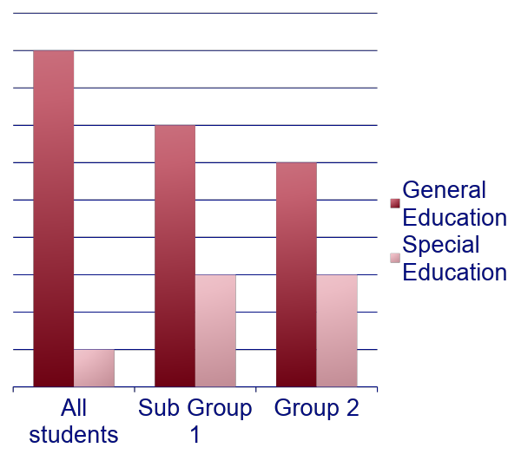
Risk Ratio Comparisons
Compares ratio of all students to a sub group

Slide 47
Strengthening Criteria for Services
Addition of state specific regulations on
Criteria to address dialect and ELL impact
Criteria to address impact of poverty (SES)
Criteria to address lack of instruction (homelessness and migrant students)
Addition of state guidance on assessment considerations
Comprehensive Assessment
Dynamic Assessment
Dialect
Bias in testing
Notes:
Assessment work in Hawaii as an example: State push towards stronger assessment (language sampling & dynamic assessment)
Wisconsin has a language sampling guidelines/handbook (developed by Jon Miller)
Marie: Diagnostic accuracy and comprehensive approach to assessment.

Slide 48
Assessment Consideration for Culturally and Linguistically Diverse (CLD) Students
Look beyond standardized and norm-referenced tests
Consider individual student differences within the context of home, community and school
Consider cultural differences
Consider socio-economic status and the impact on language and academic performance
Consider dialectal variations

Slide 49
Assessment Consideration for CLD Students
Interview parents, student (as appropriate), general education teacher, EL teacher and all other staff who work with the student
Examine all the data (state assessments, MTSS data, EL eligibility assessments, universal screeners, etc.)
Consult interpreters as necessary
Use dynamic assessment procedures
Obtain a language sample

Slide 50
Evaluation and Eligibility for Speech-Language Services in Schools
Reviews variations in terminology, federal and state regulations, and state, local, and professional guidance for cultural differences, dialect and the impact of poverty
Examines evaluation requirements and examples of differing state requirements and evidence-based recommendations
(Ireland & Conrad, 2016) http://perspectives.pubs.asha.org/article.aspx?articleid=2595559&resultClick=3

Slide 51
Best Practices
Also consider:
Degree of language proficiency with consideration for exposure and usage patterns
Quantity and quality of interactions and cultural experiences
Cultural and linguistic patterns: similarities and differences

Slide 52
Professional Development
Multiple states provide guidance and suggestions for what SLPs should do, including:
Dialectal and linguistic variation considerations in assessment, instruction, and treatment
Low SES & poverty factors in assessing risk for LI and related disabilities
Diagnostic accuracy of test and norming samples
Informing evidence based decision making processes in your school/school system
Notes:
Assessment work in Hawaii as an example: State push towards stronger assessment (language sampling & dynamic assessment)
Wisconsin has a language sampling guidelines/handbook (developed by Jon Miller)
Marie: Diagnostic accuracy and comprehensive approach to assessment.

Slide 53
Resources
ASHA Practice Portal Cultural Competence
Racial And Ethnic Disparities In Special Education
English Learner Tool Kit
Dialect & Phonemic Inventories
Understanding English Language Variation in U.S. Schools
Phonological Features of African American English
Phonemic Inventories
Poverty
Eric Jensen Teaching with Poverty in Mind
Increasing Oral and Literate Language Skills of Children in Poverty
Beginning with Babble LEAP Learning

Slide 54
Resources
Gutiérrez-Clellen, V.F., & Peña, E. (2001). Dynamic Assessment of Diverse Children: A Tutorial. Language, Speech, and Hearing Services in Schools, 32, 212-224. doi:10.1044/0161-1461(2001/019)
Harper, Charity Hudley Anne, and Christine Mallinson. Understanding English Language Variation in U.S. Schools. Teachers College Press, 2011.
Ortiz, S. O. (2006). Multicultural issues in working with children and families: Responsive intervention in the educational setting. In R. B. Menutti, A. Freeman, & R. W. Christner (Eds.), Cognitive behavioral interventions in educational settings: A handbook for practice (pp. 21–36). New York: Brunner-Routledge.
Multicultural Students with Special Language Needs Practical Strategies for Assessment and Intervention Celeste Roseberry -McKibbin Academic Communication Associates

Slide 55
Key Issue #4: State Issues with SLP Recruitment and Retention in Schools
o

Slide 56
Use State Workforce Data
Data may include
Salary
States recruited from
Years to retirement
Use this data to
Support advocacy efforts
Target recruitment trips
Align LEA practices
•
Notes:
Examples include
New York
New hampshire
virginia https://www.dhp.virginia.gov/hwdc/docs/ASLP/2202SLP2016.pdf

Slide 58
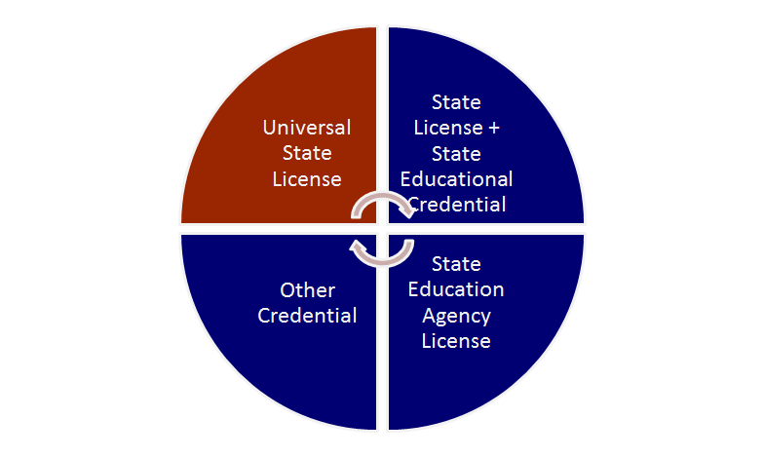
State Licensure Differences
Arizona & Colorado
Georgia
New Jersey
North Dakota
Ohio & Pennsylvania Tennessee
Hawaii
Kansas
North Carolina
Virginia
Arizona SLT
Colorado SLPA
Mississippi 216
Tennessee SL Teacher
Wisconsin SILS
Utah SLT
Notes:
temporary or emergency license Mississippi - 216 credential - to non SLP for emergency practice MS license for the bachelor’s level is a Speech Associate That person is only able to provide treatment for articulation and has several other restrictions as well
universal license
dual license
Ohio grants license if you have ccc’s but still need to obtain ODE license
AZ – health license every 2 year’s education license every 12 years – yes 12 !

Slide 60
ASHA’s Efforts
Licensure Compact
Effort to create portability across states
In development - anticipated fall 2019
Universal Licensure
Many states have universal licensure
Some are considering legislative work in this area

Slide 61
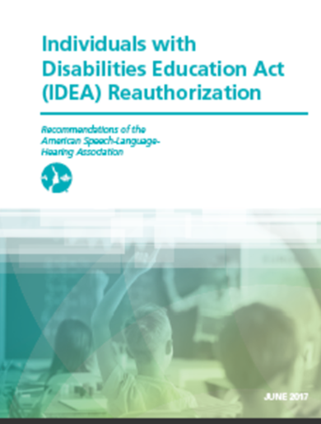
ASHA’s Efforts
Proposal: Authorize a study to look at provider caseload, workload, working environments, access to technology, and
professional development among
school-based audiologists and SLPs.
Notes:
2017

Slide 62
State Recruitment-Retention Efforts
State Recruitment Specialists
Develop programs
Gather and analyze data
Statewide recruiting and advertising
State Recruitment and Retention Incentives
CCC equivalent with National Teacher Certification
Financial incentives
Supplement for CCC-SLP (LA?)
Licensure fees paid (VA)
Loan Repayment (.......VA)
Sign on Bonus (OH)
Notes:
Related Services Workgroup in Ohio mandated by Legislature. Studying the issues. Developing short, mid and long term solutions to keep the pipeline full for slp, aud, ot, pt, nurse and psych. Leaning toward an omnie-like program which would require funding. Survey underway to collect data on working conditions, caseload, etc.
Top 5 factors for SLPs according to ASHA 200 survey data
Facility
Caseload
Training
Materials
Technology
Salary is not in the top 5!

Slide 63
Other State Efforts
Professional development support
Online modules
Support for state association conferences
Speakers and PD sessions
Offering technical assistance and resources
Website
Questions and consultations
Guidance and documents
Provide PD and materials via state system
PATTAN, TTAC, OMNIE

Slide 64
Local Recruitment - Retention Efforts
Financial Incentives
Salary scale differences/addemdums
Allowing for years of experience on pay scale
Sign-on bonuses, dues and fees
CCC equivalent with National Teacher Certification
Professional development support for conferences and speakers, materials and other supports
Specific caseloads (e.g., ECSE, AAC, only evals)
Mentoring supports
Allow telecommuting for “paperwork” days
Provide field experience for externships

Slide 65
Informed Recruiting
Provide information SLPs care about
Vary recruiting schedules
Show value for the profession
Use SLPs as recruiters & interviewers who can ask & answer specific questions
Notes:
Grass roots program in Barb’s region
-College Kids Care Packages

Slide 66
Information for Recruiting Speech-Language Pathologists (SLPs)
Overview Number of speech-language pathologists in the division: ___________ Offer CFY supervision? □ Yes □ No Lead SLP or SLP coordinator? □ Yes □ No
Caseload Information Caseload range for division ______ to ______ Caseloads adjusted based on severity of cases or amount of travel? □ Yes □ No Ages/grades for vacant position(s) □ Pre-K through age 22 □ Elementary □ Secondary □ Varies □ Specialty position (describe)

Slide 67
Types of cases:
□ Articulation □ Language □ Fluency □ Voice □ Swallowing | □ A/AC (augmentative/alternative communication) □ Autism □ Pre-School / Developmental Delays □ TBI (Traumatic Brain Injury) □ Other: ________________________________
Incentives Offered: Materials (therapy, evaluation, and continuing education) Training (registration for conferences and workshops) Technology (access to laptops, software, email, etc) Other (ASHA Dues, SHAV membership, etc.)

Slide 68
Covering Vacancies
Consider all options
Retired SLPs
Staffing companies and telepractice
Extra pay for extra work (e.g., hourly, evals, pay for work on break and holidays, 6/5ths pay…)
Clinical SLPs from hospital or clinics in community
If you still can’t cover the students:
Prioritize cases, document and communicate with families
Recruiting efforts (ads, interviews, etc.)
Records of sessions missed for students to facilitate compensatory services
Notes:
Meet w retirees annually, keep their licensure current, and split caseloads for part time work
ex: HS SLPs ending at 2pm….providing evals at elem school later in the day

Slide 69
Innovative strategies
Providing free or low-cost housing in rural areas
Four-day school week
Create district-level SLP retention plan
Conduct exit interviews that include questions specific to SLP working conditions
Give credit for years worked in non-school settings

Slide 70
Issue #5 School Based Funding and Workload Approaches

Slide 71
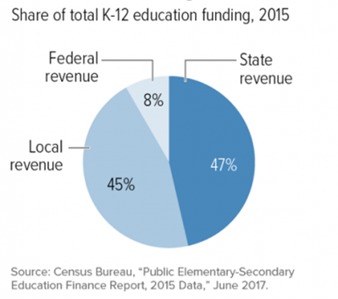
General Education School Funding

Slide 72
General Education Funds
Average Daily Membership (ADM) is used for state and local funding
State specific multiplier or adjustment may be used to calculate what each LEA receives
Poverty weighted factor (North Dakota)
Equity funding formula (Ohio)
Composite index (Virginia)
Equalization Grant (Georgia)
Virginia 15% federal 35% state 50% local | Colorado 10% federal 20% state 70% local

Slide 73
Special Education (IDEA) Funding
Each state is allocated an amount equal to the amount that it received for fiscal year 1999.
Current federal funding is under 17%
A portion of the funds may be used for state-level activities (e.g., PATTAN, TTAC, etc)
State and local dollars make up the difference

Slide 74
Funding SLP Positions
Most states fund positions using a headcount approach for all students with disabilities (e.g., December 1 Child Count)
Schools may adopt a workload approach but cannot change funding formulas without significant legislative activity
Learn about your state’s funding model and how to advocate for change

Slide 75
Medicaid Funding
Since IDEA is only funded at 17%, seeking Medicaid funds is not “double dipping”
LEAs make up ~45% of IDEA costs
LEAs may choose to use Medicaid funds to:
Replace dollars spent from general fund
Support personnel costs (salary)
Support SLPs with training and materials
Support SLP professional development

Slide 76
What is a Workload Approach?
This approach considers factors including:
Severity of cases
Transition time and travel
Evaluation of students
Responsibilities in general education / MTSS
Documentation responsibilities
Duty assignments
Staff meeting requirements

Slide 77
Workload Analysis Reveals
Work habits and patterns
Inconsistencies in evaluation and eligibility decision making
Keeping students who are ready for dismissal
Over identification
Issues with assessment practices
Use of a clinical/medical model
Service delivery issues
Same services for all students
Overuse of pull out services

Slide 78
Workload Challenges
SLP was assigned duty 2 days a week | Duty is now covered by a HS student
SLP attending meetings at all 4 buildings | Principals at 3 other buildings agree to keep SLP updated
SLP has extensive transition and travel time | Realign schedule to minimize travel
SLP keeping students on caseload until 90% accuracy in conversation | Dismissed at 75% in conversation

Slide 79
Medical vs. Educational Models
Discuss differing requirements
Educational impact and need for specially designed instruction should be considered in school settings
Guidance available from a few states
Notes:
When a medical dx is presented, groups should address the difference between educational identification under IDEA and medical diagnosis and review the criteria for the specific disability category mandated by the Virginia special education regulations.

Slide 80
Workload
ASHA supports a workload model in the schools
There are grassroots efforts underway in many local school systems to pursue a workload approach
Some states have taken strides in providing guidance documents or position statements in support of the workload approach.
Notes:
“Implementation of a workload approach is a best practice for school-based hearing and speech-language services, and it ensures compliance with IDEA and other mandates.” p.35
Individuals with Disabilities Education Act (IDEA) Reauthorization
Recommendations of the American Speech-Language-Hearing Association June 2017

Slide 81
Workload
In 2015, a few states began drafting legislative language for a workload approach.
NC uses a hybrid workload/caseload model
Ohio-In July 2014, ODE adopted language to ensure districts utilize a two-prong approach looking at workload first and then caseload.
Eight guidance videos (link) were released to support districts’ use of workload & caseload prongs.
The Ohio licensing board is working with ODE and state associations to encourage implementation of the process.
Notes:
Florida Task Force is drafting a wish list of workload approach for its schools.

Slide 82
Getting Started
Learn about your state and local funding sources
Review workload factors
Build consensus with other SLPs
Share information about workload approaches with others
Advocate for:
Workload approach at LEA level
Workload approach at SEA level
Funding formula changes

Slide 83
www.seacdc.org

Slide 84
Time for Questions
Regulations
Evidence based practice
Students who are English Language Learners
Recruitment and retention
Workload and Funding
Other Topics??

Slide 85
Thank you for joining us!

Slide 86
References
ASHA (2010). Roles and responsibilities of speech-language pathologists in schools [Professional Issues Statement]. Available from www.asha.org/policy.
ASHA (2014a). 2014 Schools Survey, Caseload Characteristics Trends. Rockville: Author.
ASHA (2014b). 2014 Schools Survey, Educational Audiologists. Rockville: Author.
ASHA (2014c). 2014 Schools Survey, Speech-language Pathologists. Rockville: Author.
Dixon, D. (December, 2013). School matters: Response to intervention; Turning a challenge into an opportunity. ASHA Leader, 18, 30-31.

Slide 87
References
National School Boards Association (March 5, 2015). Letter of response to US Department of Education. Retrieved from www.nsba.org
Rudebusch, J., & Wiechmann, J. (August, 2011). How to fit response to intervention into a heavy workload. ASHA Leader.
Rudebusch, J., & Wiechmann, J. (August, 2013). Time block after time block. ASHA Leader, 18, 40-45.
USDOE (2015). Building the legacy: IDEA 2004. Retrieved from idea.ed.gov

